Slide 1

Thai Medical Women’s Association (TMWA) Under The Royal Patronage of Her Majesty The Queen
The 4th International Congress on Women’s Health and Unsafe Abortion
ROLE OF THE THAI MEDICAL WOMEN’S ASSOCIATION
ON PREVENTION OF UNSAFE ABORTION IN WOMEN’S HEALTH
Darunee Buddhari, Surangrat Vardhanabhuti, Mayura Kusum,
Somsiri Sakolsatayadorn, Jantra Chennavasin, et al.
20 February 2019
ASIA Hotel, Bangkok Thailand

Slide 2
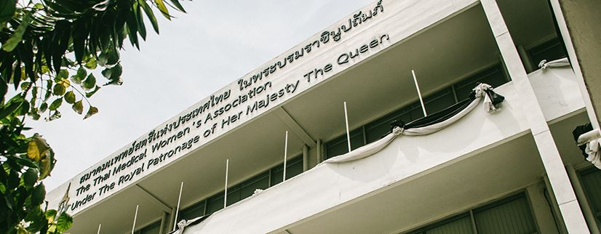
TMWA Introduction
Thai Medical Women’s Association (TMWA) Under The Royal Patronage of Her Majesty The Queen
The TMWA started to deliver the health care to society in 1951, then formal and legalized establishment in 1960.
Under the Royal Patronage of Her Majesty the Queen Sirikit on 12 August 1965.
The present building was graciously inaugurated by H.M. the Queen on 29 June 1981.

Slide 3
TMWA Introduction
Thai Medical Women’s Association (TMWA) Under The Royal Patronage of Her Majesty The Queen
Mission
Exalt Medical Women Status and Dignity
Provide Public Service focusing on Women’s Health
Collaborate In-country and International Working Network
Resolution
TEAM MORAL WISDOM ALTRUISM

Slide 4
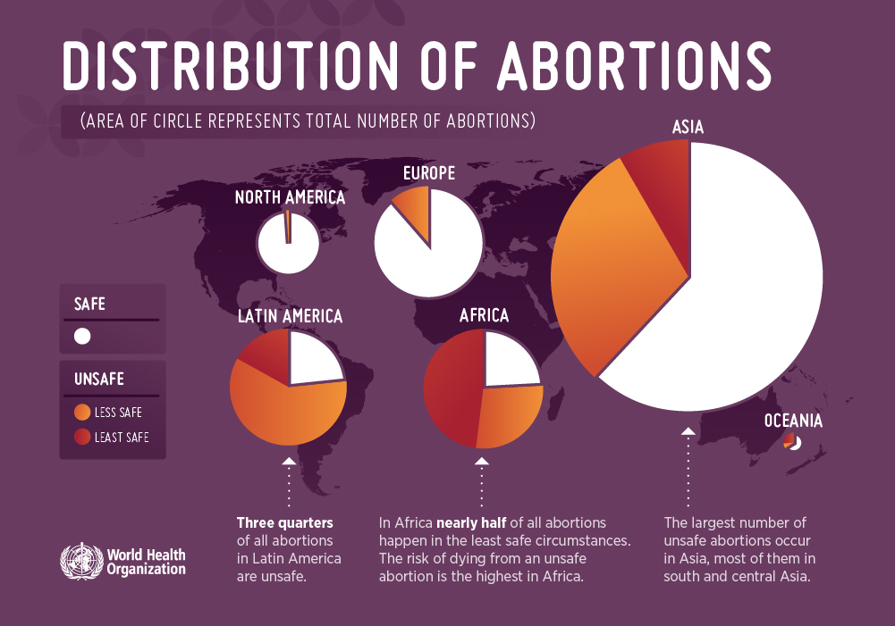
Unsafe Abortion
Thai Medical Women’s Association (TMWA) Under The Royal Patronage of Her Majesty The Queen
Unplanned/ Unintended Pregnancies
Termination
Complicated Deliveries
Unsafe Abortion
News Release WHO- 28 September 2017

Slide 5
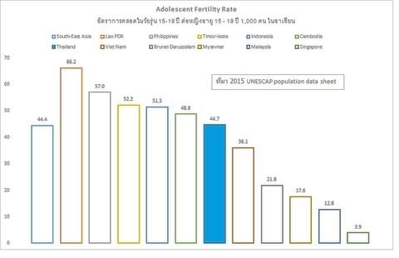
Teenage Pregnancy Initiative Project
Thai Medical Women’s Association (TMWA) Under The Royal Patronage of Her Majesty The Queen
Established in year 2016
Average Birth 1.6 child/family (2016)
UNESCAP- United Nations Economic and Social Commission for ASIA and the Pacific

Slide 6
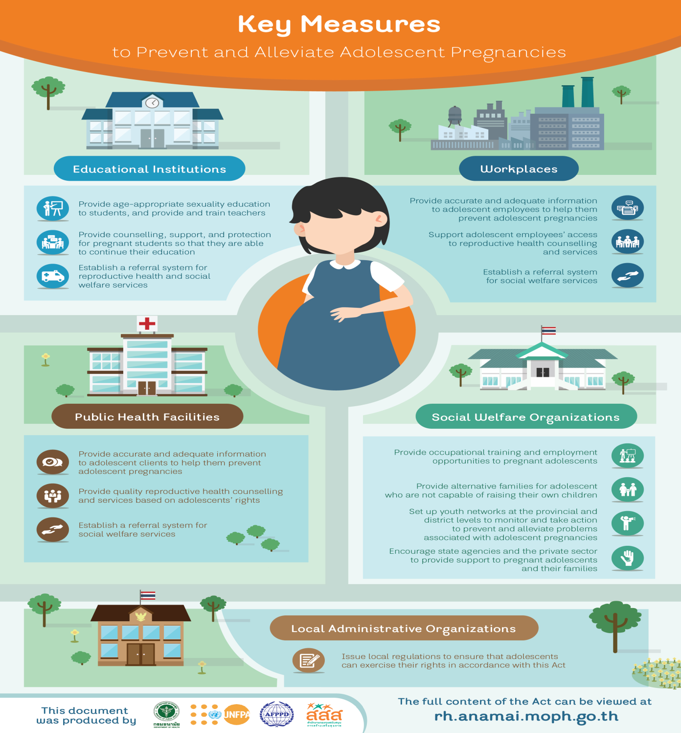


Thai Medical Women’s Association (TMWA) Under The Royal Patronage of Her Majesty The Queen
5 National Strategies
9 Missions from Thai Health Promotion Foundation

Slide 7
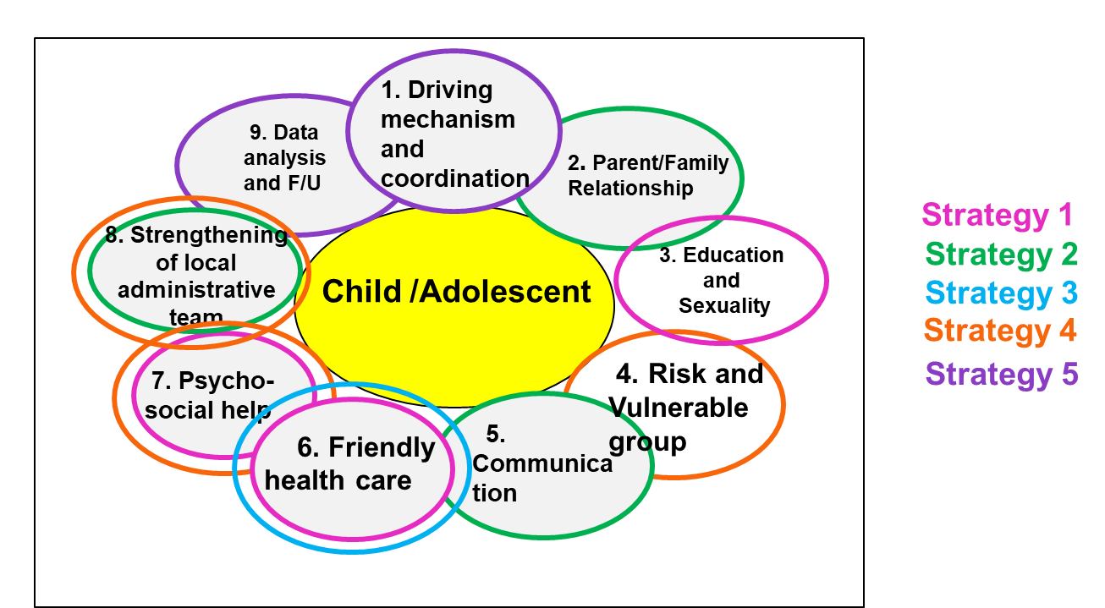

Thai Medical Women’s Association (TMWA) Under The Royal Patronage of Her Majesty The Queen
Education
Fam&Com
Health Care
Social Welfare
Integration, KM
Notes:
Strategy 1: Develop the sexuality education and quality life Skill including supporting system
Strategy 2: Encourage the family, community engagement in parent/family relationship
Strategy 3: Develop the friendly health care system
Strategy 4: Develop the social welfare support
Strategy 5: Integrate the data , knowledge management and Research

Slide 8
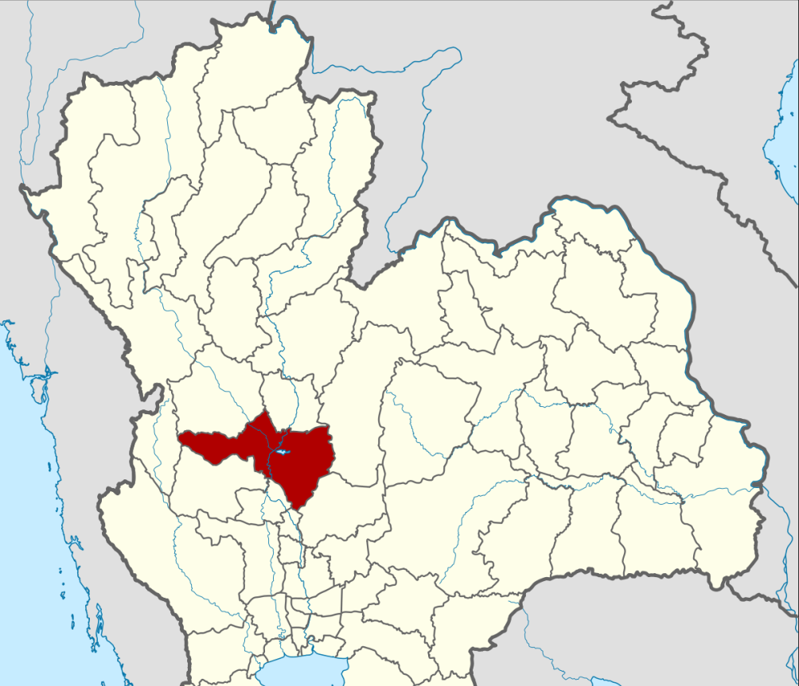
Nakornsawan Model
Thai Medical Women’s Association (TMWA) Under The Royal Patronage of Her Majesty The Queen
Lower- Northern region
Area- 9,597 km²
1,063,924 population (2018)
Teenage Pregnancy Situation (2018)
1.53/1000 population (index <1.3/1000 population)

Slide 9
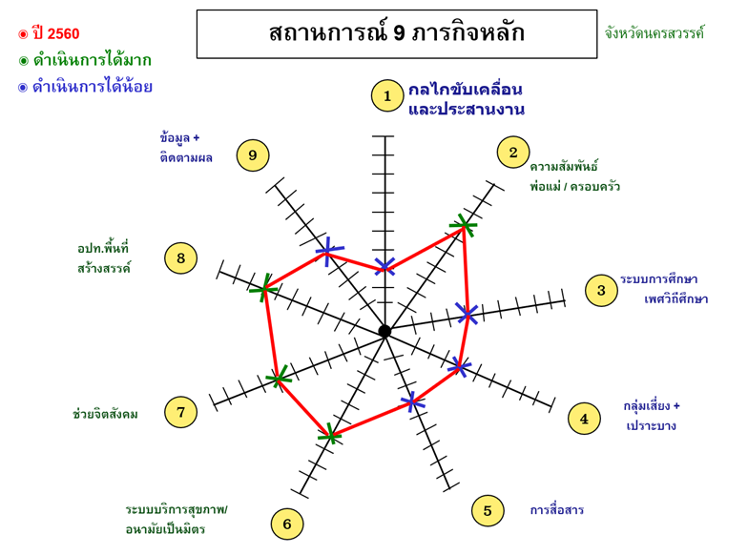
Situation Analysis
Thai Medical Women’s Association (TMWA) Under The Royal Patronage of Her Majesty The Queen
Year 2017
More
Less
Situation of 9 Missions
Driving mechanism and coordination
Data monitoring
and analysis
Parent/Family
Relationship
Strengthening of local administrative team
Education
and
Sexuality Education
Psycho-social help
Risk and Vulnerable group
Friendly health care
Communication

Slide 10
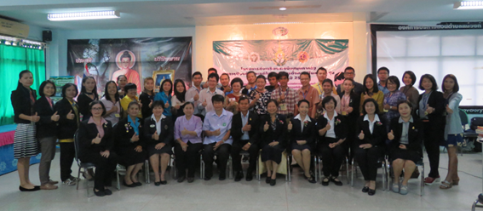
Activities(I)
Thai Medical Women’s Association (TMWA) Under The Royal Patronage of Her Majesty The Queen
Coordinate and Strengthening the working network between government agencies, communities, local administrative and private organization

Slide 11
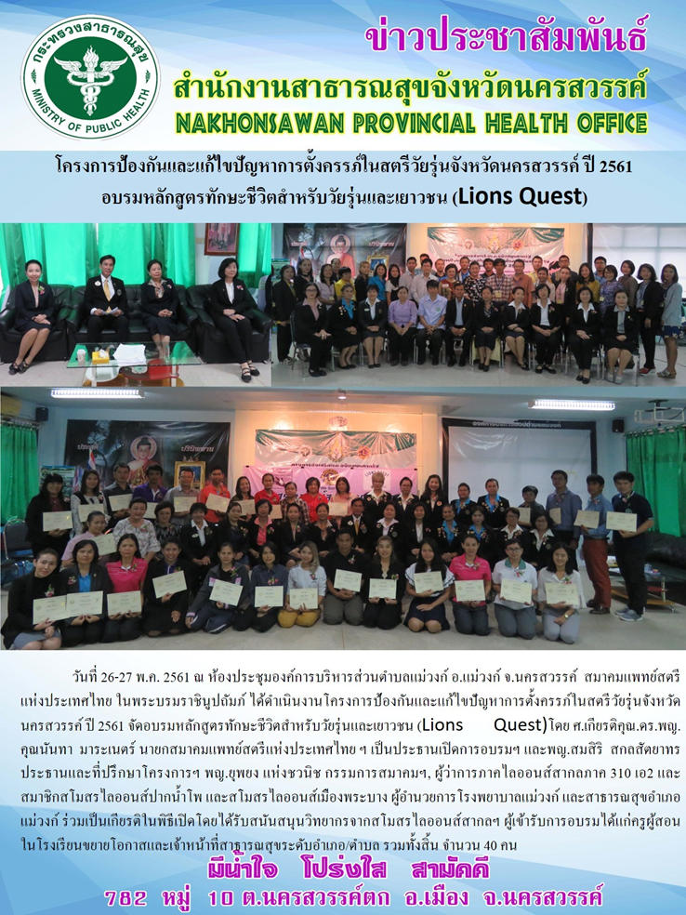
Activities (II)
Thai Medical Women’s Association (TMWA) Under The Royal Patronage of Her Majesty The Queen
Educational support for the trainer group* – Skill for adolescents ‘Lion Quest’ in 3 districts – Taklee, Maewong and Ladyao
*Budget support by Department of Health Service Support, Thai MOPH

Slide 12
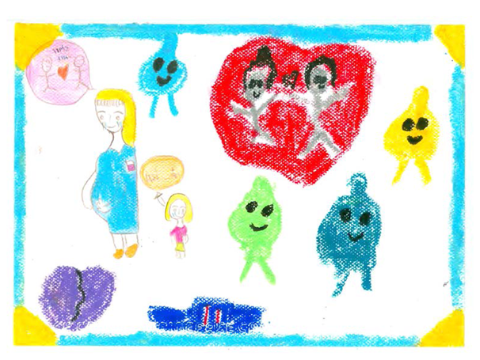
Conclusion from the first 2years
Thai Medical Women’s Association (TMWA) Under The Royal Patronage of Her Majesty The Queen
Provincial Team Work Collaboration – Top-down through community ‘Strength’
Effective tools in monitoring and follow up
Integration of Network

Slide 13
Summary
Thai Medical Women’s Association (TMWA) Under The Royal Patronage of Her Majesty The Queen
This ‘FIRST’ defender of ‘Teenage pregnancy’ problem will help to prevent unsafe abortion in the future.
Teenage Pregnancy
Unsafe Abortion

Slide 14
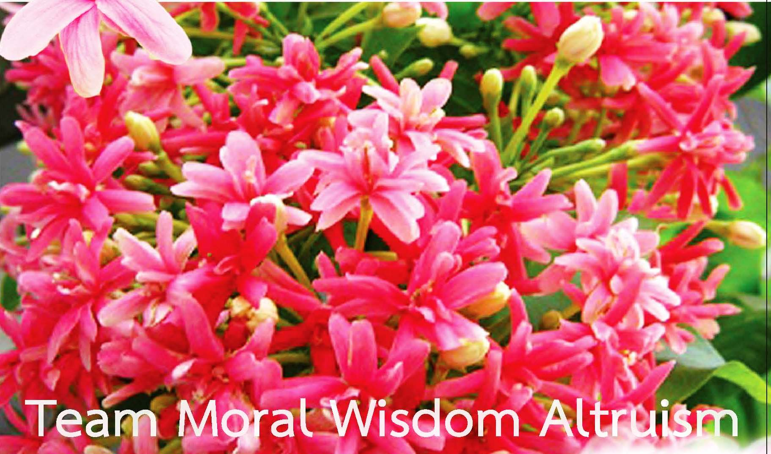
THANK YOU
Notes:
Rangoon creeper Flower

